Slide 1
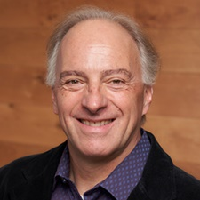
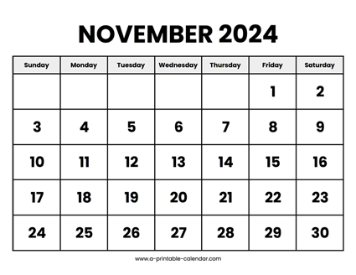

CS 310 : Scalable Software Architectures
Week 08 (Nov 11 – Nov 15)
This week in CS 310:
Focus this week:
Software execution, VMs, Docker
Async architectures, Distributed Systems
CAP
Project 03 has been released
Serverless, event-driven PDF analysis
Due Friday November 15th (late Sunday Nov 17th)

Slide 2
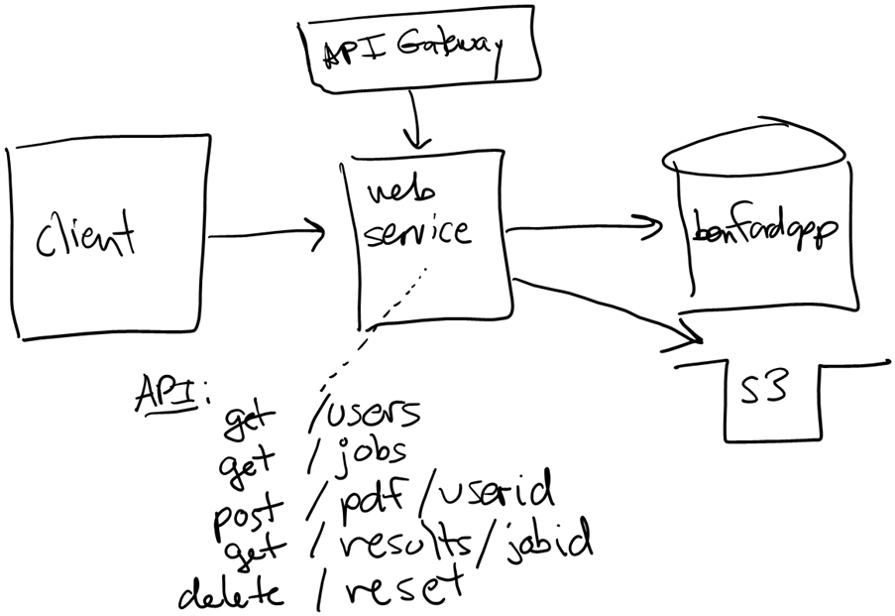
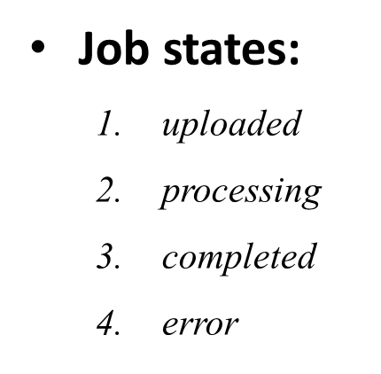
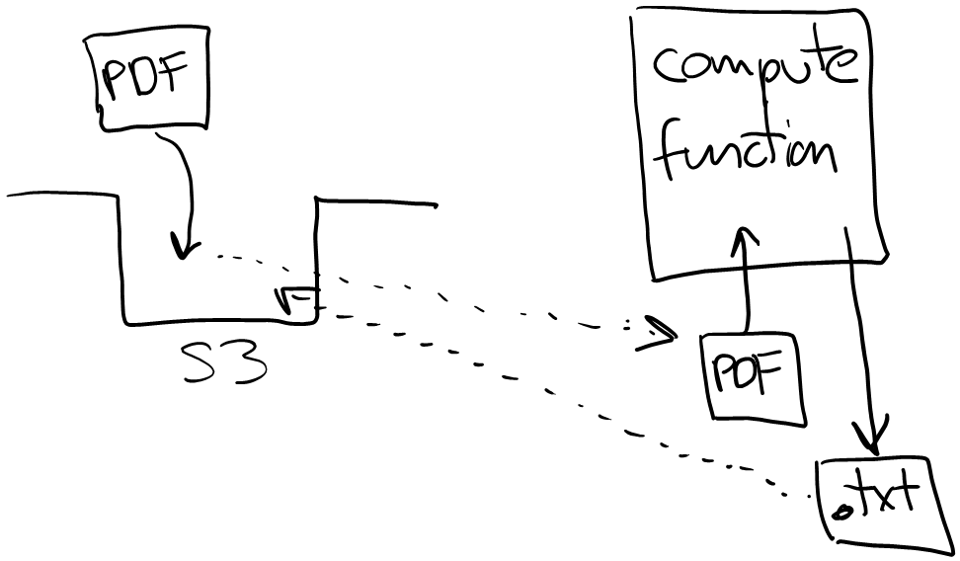
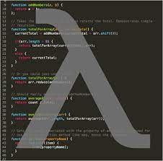
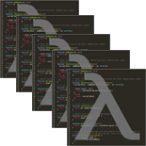
Project 03
Project 03 uses a different architectural approach:
Event-driven
Serverless
Asynchronous API

Slide 3
Topics
Software execution and packaging
Virtual machines
Docker
Async architectures
Queueing
Distributed systems
CAP theorem

Slide 4
Class sessions
Tuesday:
Hands on with Docker
Thursday:
We may cancel the class session

